Slide 1
Applet Programming

Slide 2
What is Applet?
Applet is a special type of program that is embedded in the webpage to generate the dynamic content.
It runs inside the browser and works at client side.
What are Java Applets used for? Java Applets are usually used to add small, interactive components or enhancements to a webpage.

Slide 3
Why to use Applet?
Web developers are plagued by the inconsistent browser rendering of HTML and JavaScript, yet most continue to use HTML forms to build GUI front-ends.
Since Java's bytecode is platform-independent, Java applets can be executed by browsers running under many platforms
When a Java technology-enabled web browser processes a page that contains an applet, the applet's code is executed by the browser's Java Virtual Machine (JVM).

Slide 4
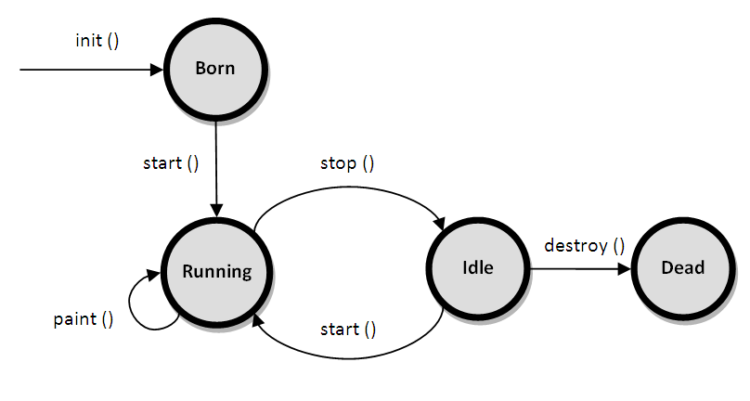
Life cycle of Applet

Slide 5
...Contd
For creating any applet Applet class must be inherited. It provides 4 life cycle methods
public void init() → To initializ the Applet. It is invoked only once.
public void start() → Invoked after the init() method or browser is maximized. It is used to start the Applet.
public void stop() → Used to stop the Applet. It is invoked when Applet is stop or browser is minimized.
public void destroy() → Used to destroy the Applet. It is invoked only once.

Slide 6
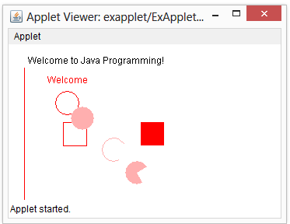
Example for Applet Program
import java.awt.*;
import java.applet.*;
public class ExApplet extends Applet
{
public void paint(Graphics g)
{
g.drawString("Welcome to Java Programming!", 25, 25 );
g.setColor(Color.red);
g.drawString("Welcome",50, 50);
//x1,y1,x2,y2
g.drawLine(20,30,20,300);
//x,y,width,height
g.drawRect(70,100,30,30);
g.fillRect(170,100,30,30);
g.drawOval(60,60,30,30);
g.setColor(Color.pink);
g.fillOval(80,80,30,30);
g.drawArc(120,120,30,30,30,270);
//fillArc(int x1,int y1, int width, int height,int startAngle, int arcAngle)
g.fillArc(150,150,30,30,30,270);
}
}

Slide 7
How to execute Applet program?
Modern browsers come with applet capabilities.
<html>
<body>
<applet code="GraphicsDemo.class" width="300" height="300">
</applet>
</body>
</html>
The JDK also comes with an applet viewer.
appletviewer only understands <applet> tags
Executing the applet
appletviewer WelcomeApplet.java
Perform in directory containing .class file

Slide 8
Example – Bouncing ball
Step1: Draw a ball
Step 2: Position the ball at different place every time
Step 3: Paint each time at different position continuously
Step 4: Make thread to execute this
Step 5: Retrieve the height and width of the window

Slide 9
package exapplet;
import java.awt.*;
import java.applet.*;
public class Exbouncingball extends Applet implements Runnable{
int x,y;
int incx,incy;
public void init()
{ x=20; y=20; incx=1; incy=1; }
public void start()
{ Thread th=new Thread(this);
th.start(); }

Slide 10
public void run() {
while(true)
{
repaint();
try
{ Thread.sleep(50); }
catch(Exception e)
{ }

Slide 11
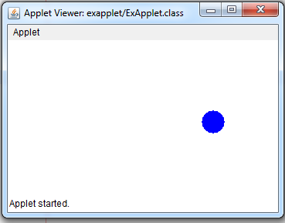
int width = getWidth();
int height = getHeight();
if(x+40>width) incx=-1;
if(x<10) incx=1;
if(y+40>height) incy=-1;
if(y<10) incy=1;
x=x+incx;
y=y+incy;
} }
public void paint(Graphics g)
{ g.drawOval(x,y,20,20); }
}

Slide 12
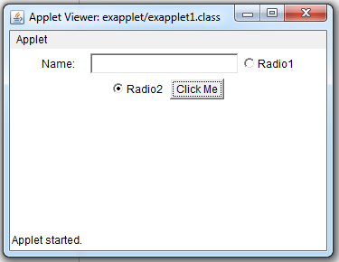
Creation of form using Applet
import java.awt.*;
import java.applet.*;
public class exapplet1 extends Applet
{ public void init()
{ Label label1=new Label("Name:");
//setBounds(x, y, width, height)
label1.setBounds(70,90,90,60); add(label1);
TextField name=new TextField(20);
name.setBounds(90,90,90,60); add(name);
CheckboxGroup radioGroup = new CheckboxGroup();
Checkbox radio1 = new Checkbox("Radio1", radioGroup,false);
Checkbox radio2 = new Checkbox("Radio2", radioGroup,false);
radio1.setBounds(20,120,100,30); add(radio1);
radio2.setBounds(140,120,100,30); add(radio2);
Button ok=new Button("Click Me");
ok.setBounds(170,120,100,30); add(ok);}}

